Slide 1

Forecasting Workplace Absenteeism
By: Myra Rust

Slide 2
Introduction
Background
Research Questions:
Can absenteeism be forecasted using employee demographic information?
What are the main factors of absenteeism?
Are there patterns in absence rates by season, month, or day of the week?

Slide 3
dataset
Original data source
Collected in Brazil from 2007 -2010
Followed 36 employees
740 observations
21 features

Slide 4
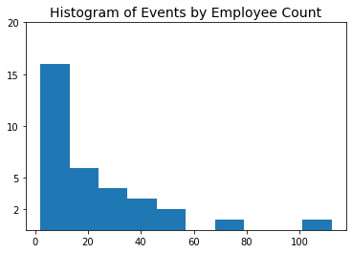
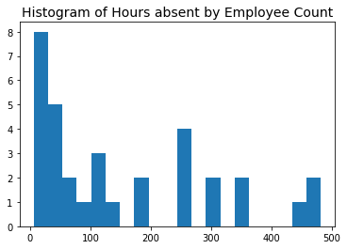
Preliminary Analysis

Slide 5
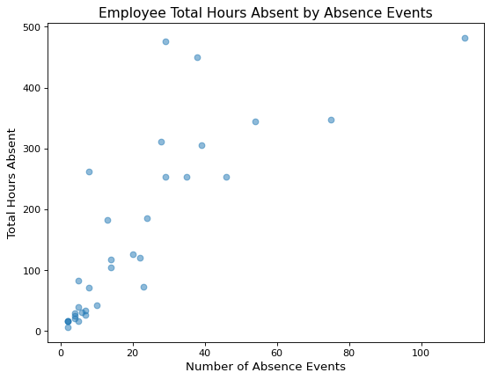
Hours and events by employee

Slide 6
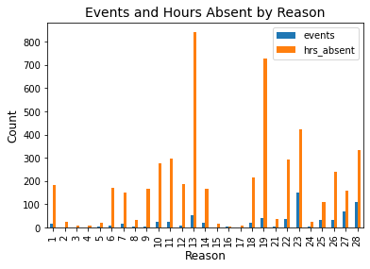
Hours and events by reason

Slide 7
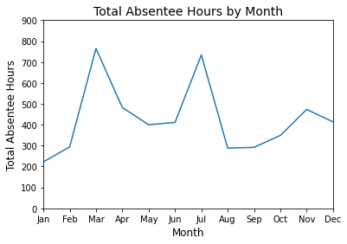
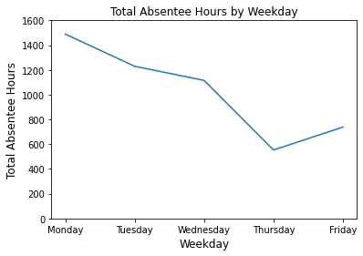
Hours by Month & Weekday

Slide 8
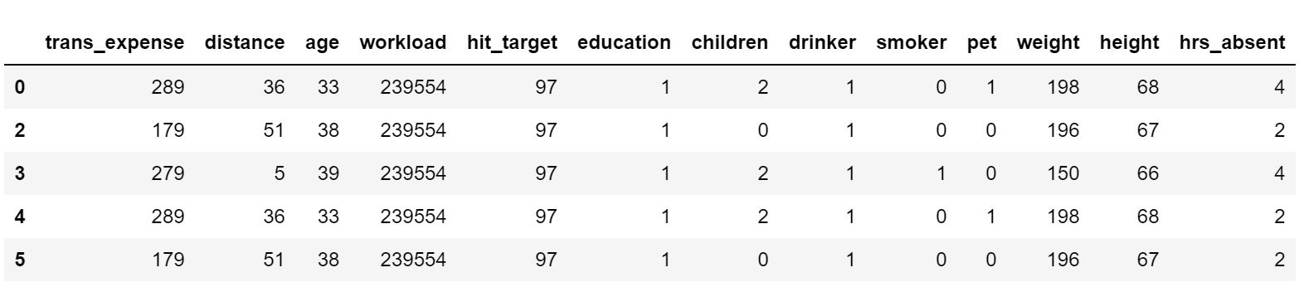
Cleaned Dataset
Removed columns due to correlation and to prevent bias in modeling

Slide 9
Data transformation
One-hot encoded categorical variables
MinMaxScaler applied to dataset
70/30 Train-Test Split
Training set: 487 observations
Test set: 209 observations

Slide 10
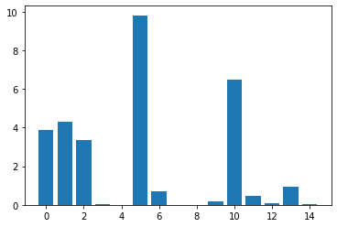
Feature selection
Correlation feature selection method used
Kbest identified 5 important features

Slide 11
Model Selection & Evaluation
Model | MAE | RMSE | R2
Baseline Regressor |  |  | <0.00003
Linear Regression w/all features | 0.057 | 0.122 | 0.027
Linear Regression w/selected features | 0.055 | 0.121 | 0.043
Decision Tree Regressor | 0.071 | 0.183 | -1.198
Random Forest Regressor | 0.060 | 0.140 | -0.276

Slide 12
Conclusion
Current demographic features not sufficient to create accurate model
No to weak correlation with target
Unable to use HIPAA protected information
Need additional features to produce valuable model

Slide 13
Future work
Explore creating models with season, month, and weekday data
Explore additional information:
Position (junior, management, executive, CEO)
Physical demand (desk-based, active movement, manual labor)
Employer offer PTO and/or sick leave

Slide 14
references
Dua, D. and Graff, C. (2019). UCI Machine Learning Repository [http://archive.ics.uci.edu/ml]. Irvine, CA: University of California, School of Information and Computer Science.
Martiniano, A., Ferreira, R. P., Sassi, R. J., & Affonso, C. (2012). Application of neuro fuzzy network in prediction of absenteeism at work. In Information Systems and Technologies (CISTI), 7th Iberian Conference on (pp.1-4). IEEE.
Stinson, C. (2015, January 28). Worker Illness and Injury Costs U.S. Employers $225.8 Billion Annually. CDC Foundation. Retrieved from https://www.cdcfoundation.org/pr/2015/worker-illness-and-injury-costs-us-employers-225-billion-annually.

